Slide 1
Current

Slide 2
By the end of this lesson you will be able to:
Describe what electric current is.
Explain how we measure electric current.
Examine how we describe the direction of current movement according to scientific convention.

Slide 3
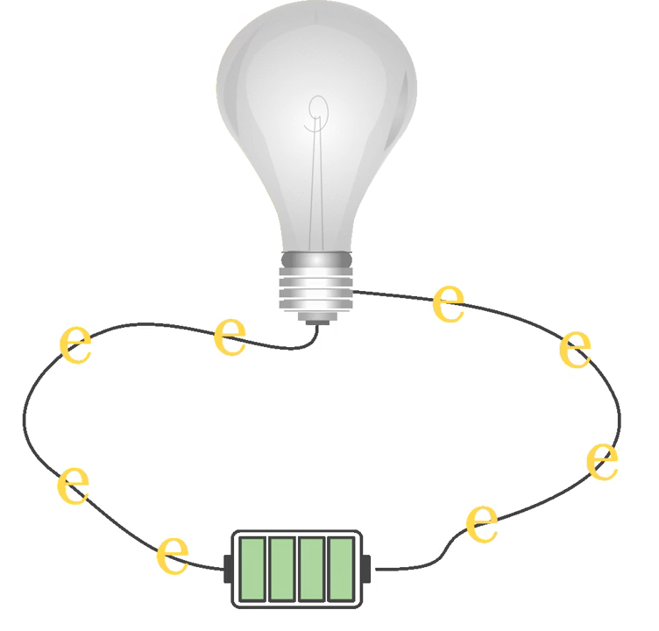
Current is the flow of charge, which transfers energy around a circuit.
Charge flows through a circuit like a river! When a circuit is complete and includes an energy source, charged particles are pushed around the circuit via the wires.

Slide 4

We can measure the current and give it a numerical value.
The amount of current going around a circuit is measured in amperes, or amps for short. This is given the symbol A.
Remember, current is the flow of charge. Measuring the current is a bit like standing in a river and watching the water rushing past you, and being able to measure how much water rushes past in a second!

Slide 5

Being able to measure the current is important for understanding how a circuit works.
Check out this video (0:24) for a quick explanation on measuring the strength of a current.

Slide 6
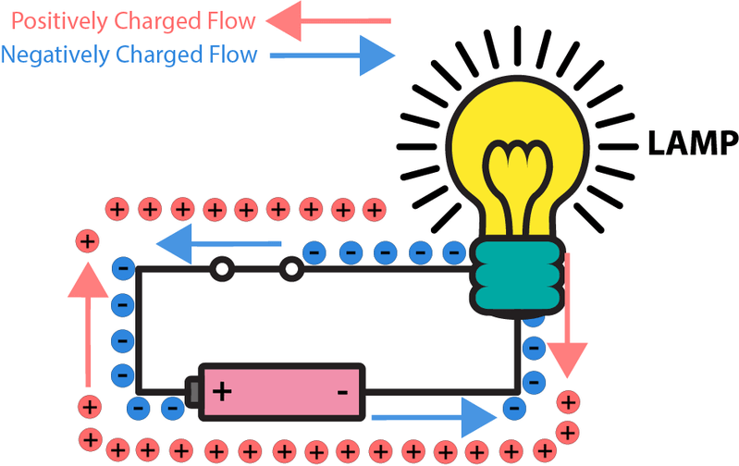
Scientists around the world continue to use this convention to describe the direction of current flow.
The established convention describes the current in a circuit as moving from the positive end of a battery through the wires to the negative end.
However, electrons actually move in the opposite direction to this!

Slide 7
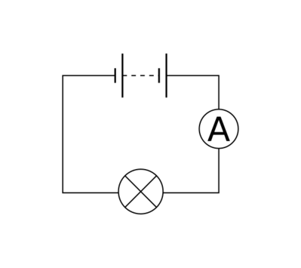
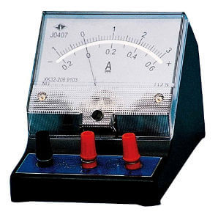
To measure current, we use an ammeter.
We measure current in line within the circuit. This is because the electrons have to pass through the ammeter for the charge to be measured.
An ammeter measures the amount of charge passing through it per second. A larger current has more amps and therefore a higher charge than a smaller current.
The A-symbol in the circuit next to the ammeter below shows how we represent the ammeter in a circuit diagram.

